Slide 1
SBA To Provide Economic Injury Disaster Loans
For Coronavirus Related Economic Disruptions

Slide 2
Disaster Loan Application Portal (DLAP)

Slide 3
Disaster Loan Application Portal
This presentation will provide guidance on how to complete an Electronic Business Application utilizing SBA Form 5 and SBA Form 5C. Before starting this process, please insure you have the filing requirements as defined in this document. These documents are required for processing an EIDL application.

Slide 4
Filing Requirements
Electronic Loan Application (Form 5)
Electronic Loan Application (Form 5C) Sole Proprietorship Only
Tax Authorization (Form 4506-T) 20% Owners/GP/50% Affiliate
Most recent Business Tax Return
Personal Financial Statement (Form 413) 20% Owners/GP
Schedule of Liabilities (Form 2202)

Slide 5
Disaster Loan Application Portal (DLAP)
DOUBLE-CLICK ON THE LINK TO ACCESS THE SITE
https://disasterloan.sba.gov/ela/
DOUBLE-CLICK APPLY ONLINE

Slide 6
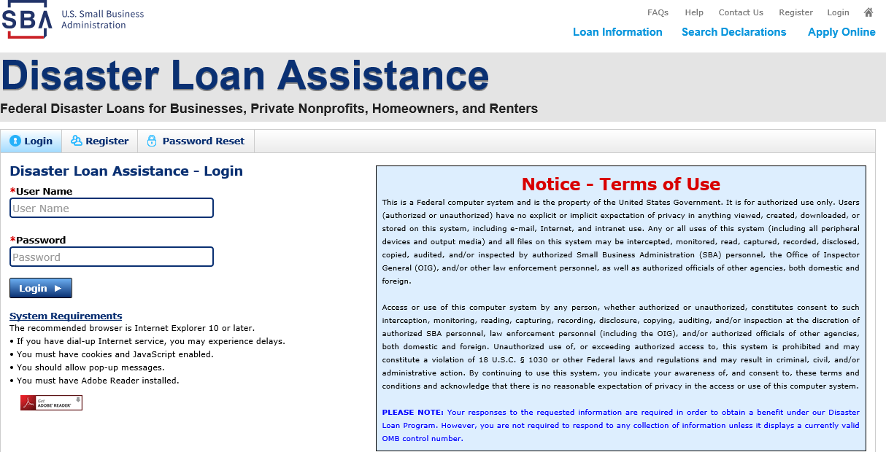
Register
From this page you can:
1) Begin a new application by clicking on Register
2) Return to complete a started application by inputting a user name and password

Slide 7
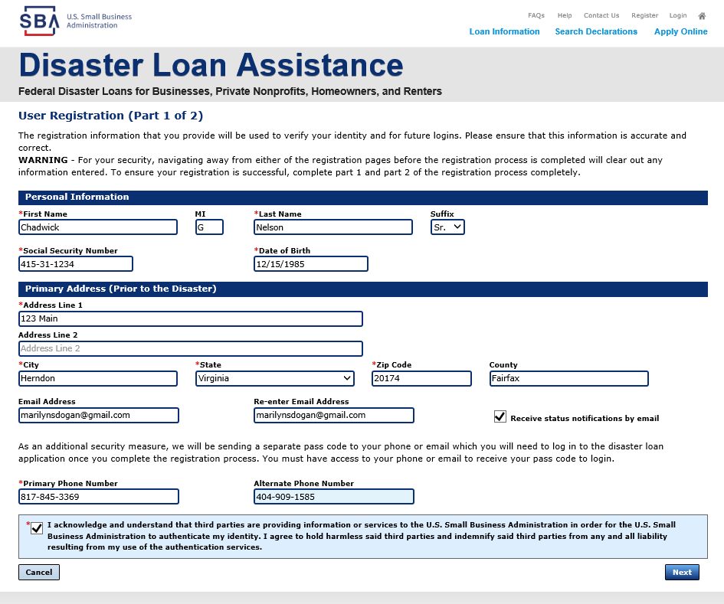
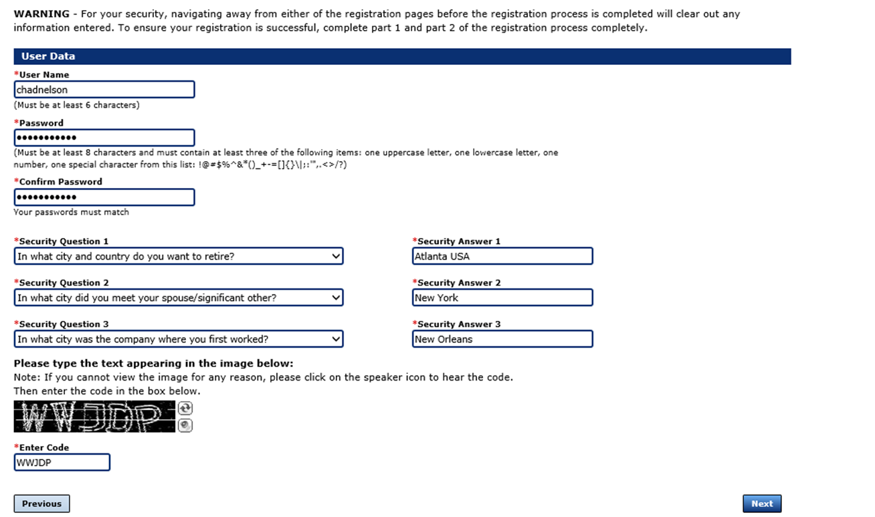
Complete Registration Information
On page 1 of the registration, pay close attention to the sections with an * these sections must be completed. It is important that a good email address and cell phone number are supplied.
On page 2 of the registration you will create your unique user-name and password. When creating your security questions, make sure to use information you won’t likely forget. If your password ever requires a reset, you would need this information
To advance to the next page, go next

Slide 8
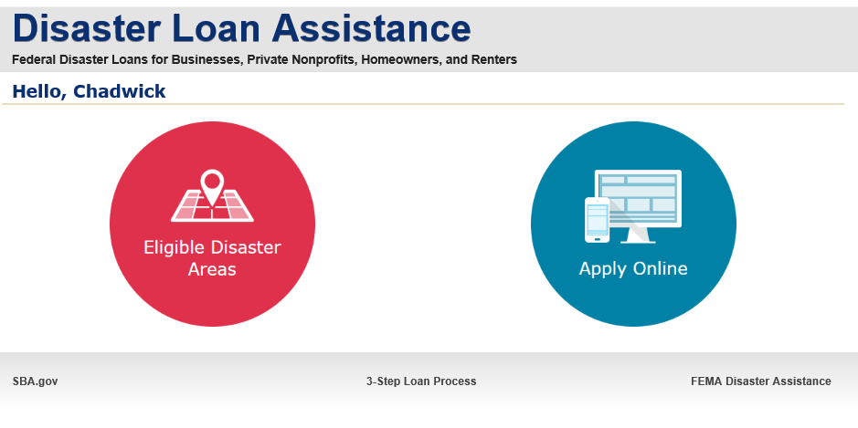
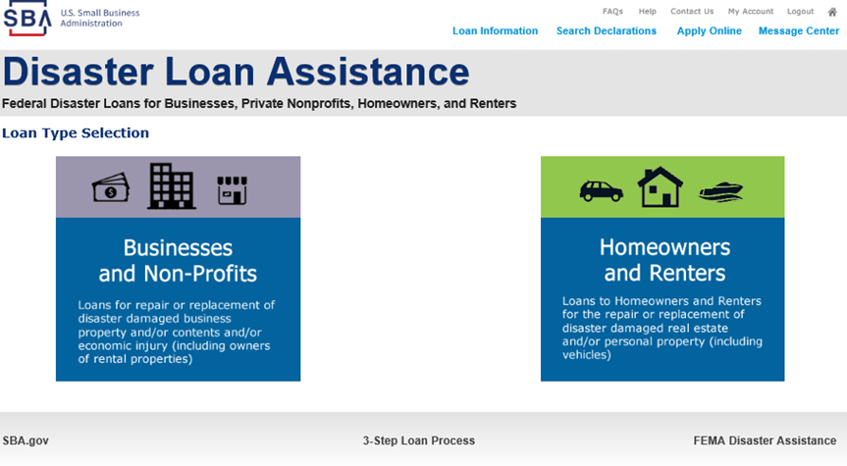
Apply Online
Double Click on “Apply Online”
Double Click on Business and Non Profit

Slide 9
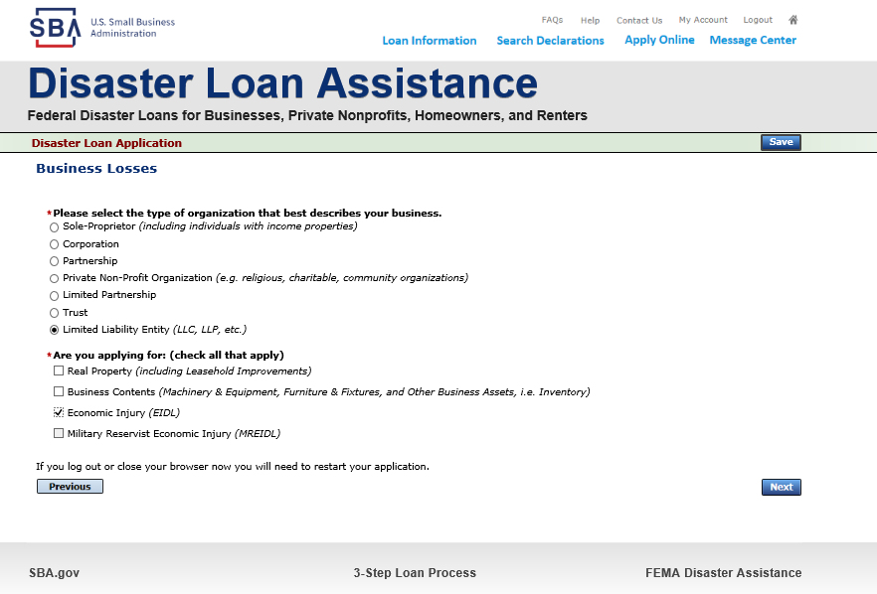
Business Type
SBA Form 5 would be completed by:
Corporations
Partnership
Private Non-Profit Organizations
Limited Partnership
Trust
Limited Liability Entity
SBA Form 5C would be completed by:
Sole Proprietorship
Once you make your selection the system will automatically direct you to the form.

Slide 10
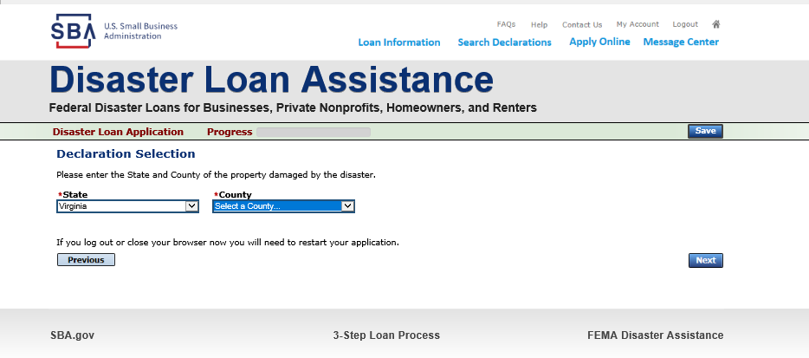
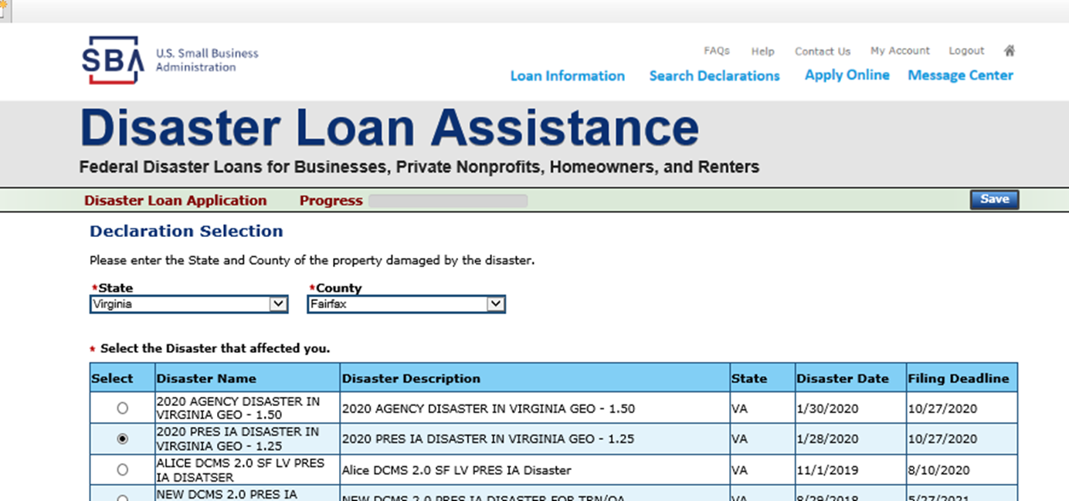
Select State /County / Disaster Declaration
Use the drop-down box and select the State and County where the loss has happened
Select the disaster declaration

Slide 11
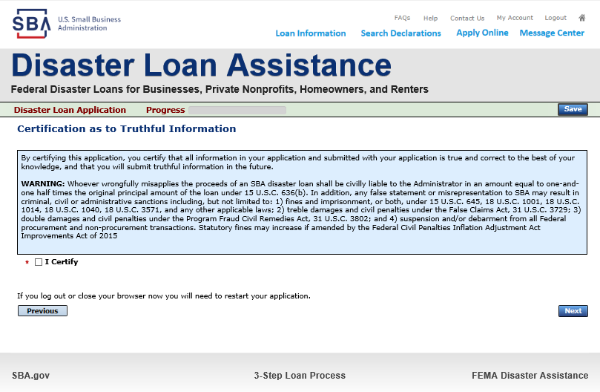
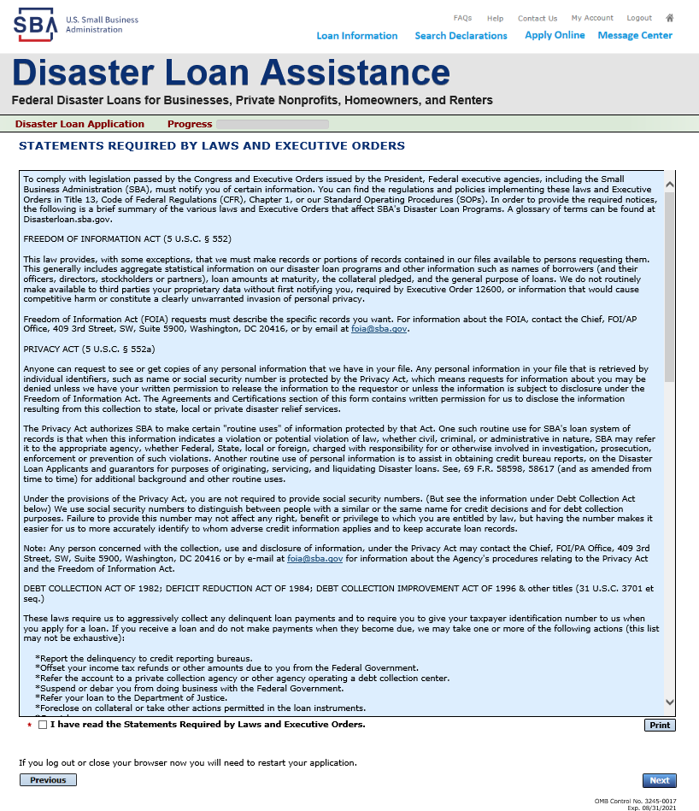
Complete Certifications
Read and Electronically Agree to the Certification of Truthful Information and the Executive Orders Document.

Slide 12
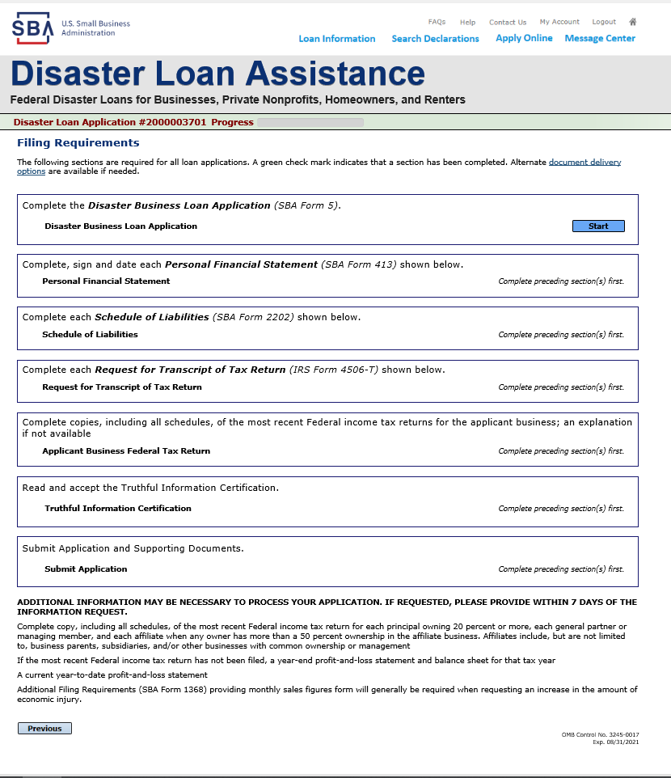
Start Application – Form 5
This business type for this example is an LLC.
This page provides information on all the filing requirements necessary to have a successfully completed application.
To begin depress START

Slide 13
Form 5 – Page 1
Fill in the information on this page as necessary, items with a red * are mandatory field and you will not be able to advance to NEXT until these sections are completed.

Slide 14
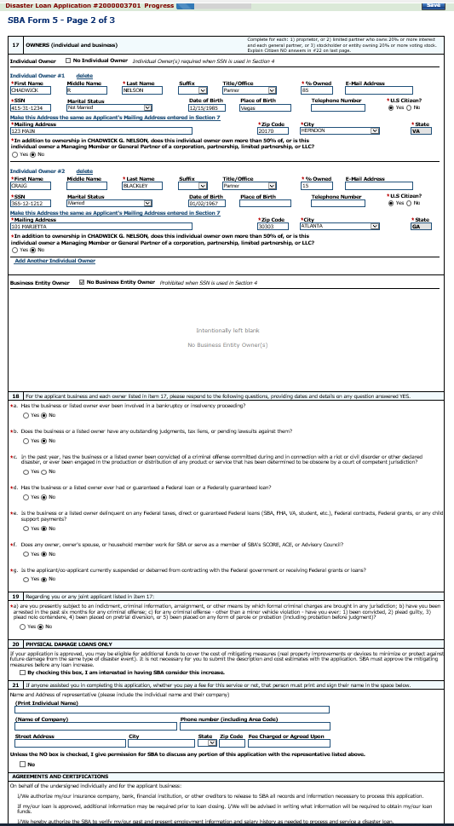
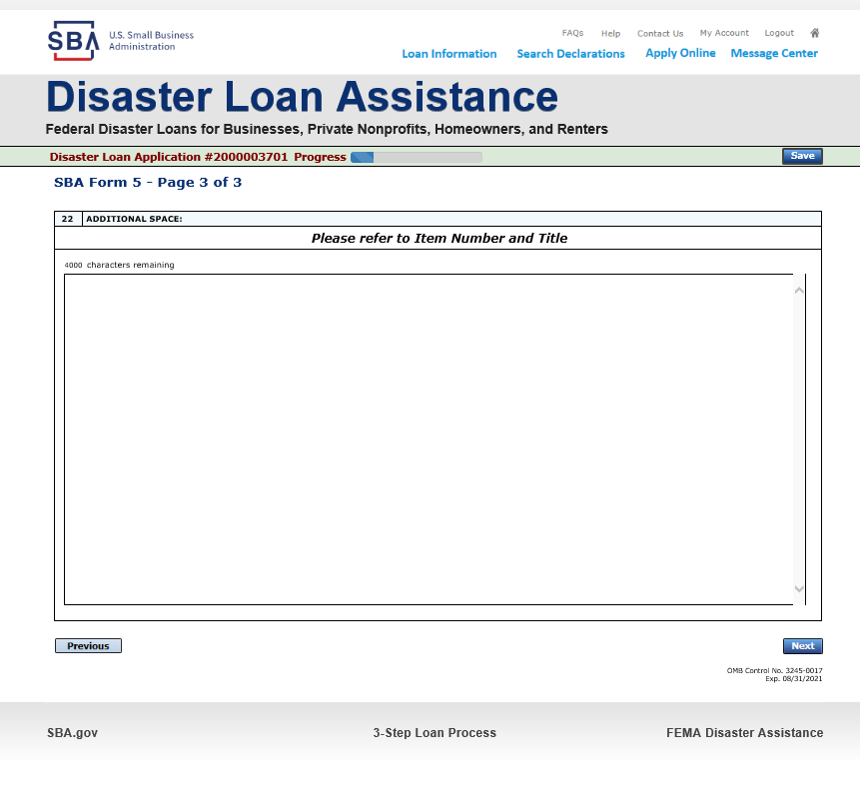
Form 5 – Pages 2 and 3
Page 3 is used for any relevant comments
Page 2 of Form 5 allows the business owner to provide information about any Partners or Affiliate Businesses.
Note: If a business is a partnership all members must listed with the % of ownership until the combined entries equal 100%

Slide 15
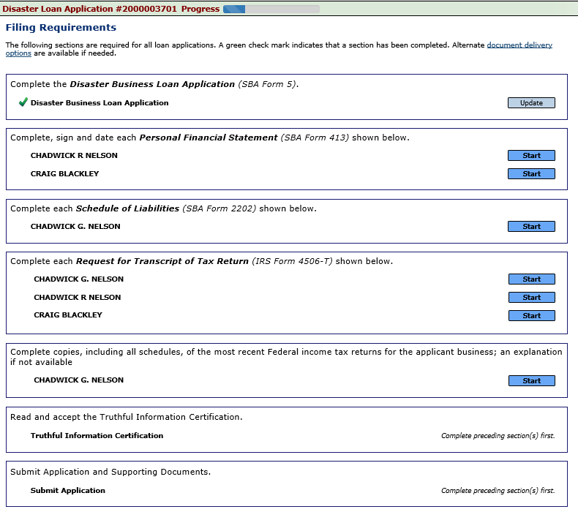
Filing Requirements
Now that the application is complete, the filing requirements on this page must be submitted / uploaded to complete the process.

Slide 16
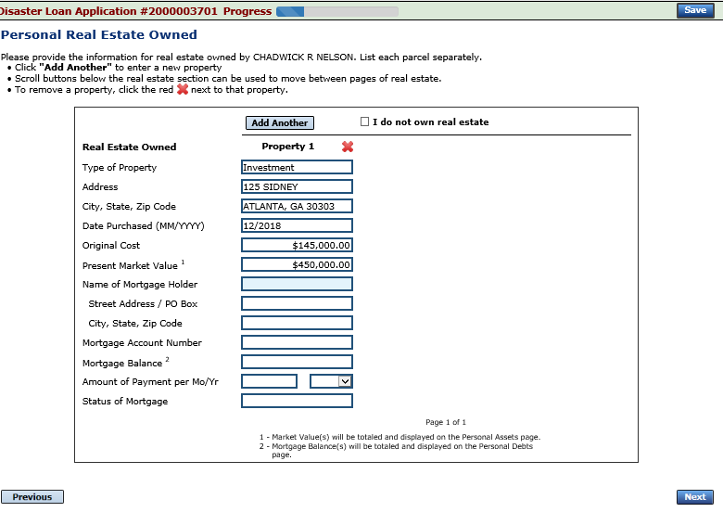
Personal Financial Statement
You can use this form to complete your personal financial statement or upload a financial statement you already have by scanning and uploading that document
If you indicated you have real estate you must complete this form, supplying additional information

Slide 17
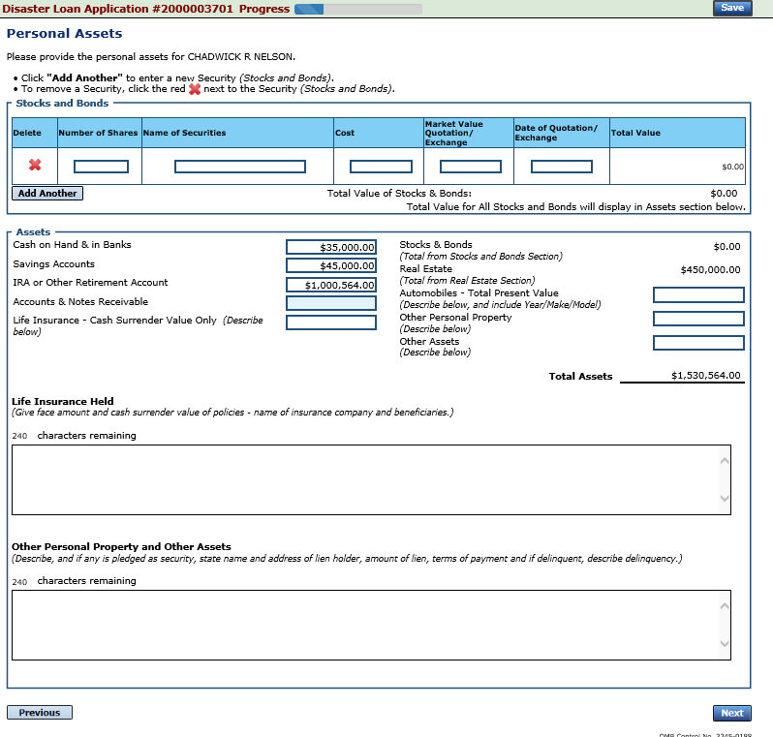
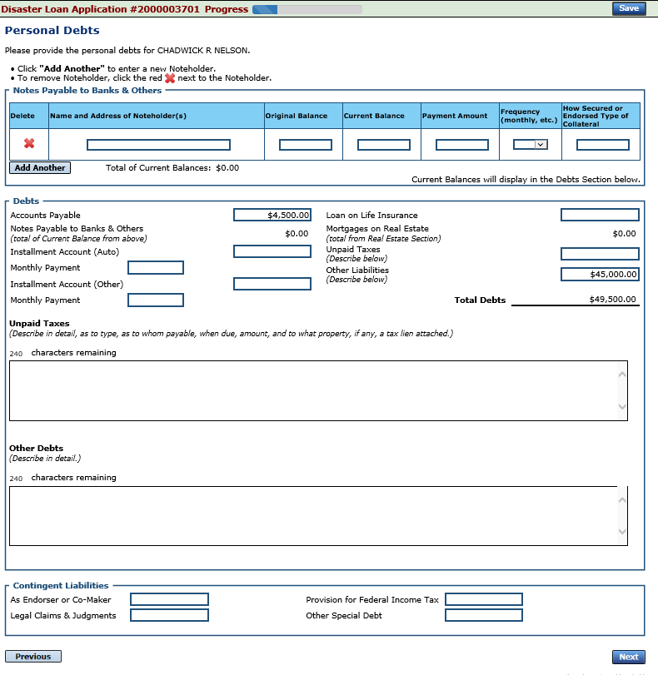
Personal Assets / Debits
The applicant and any partner would need to provide information on assets and debits

Slide 18
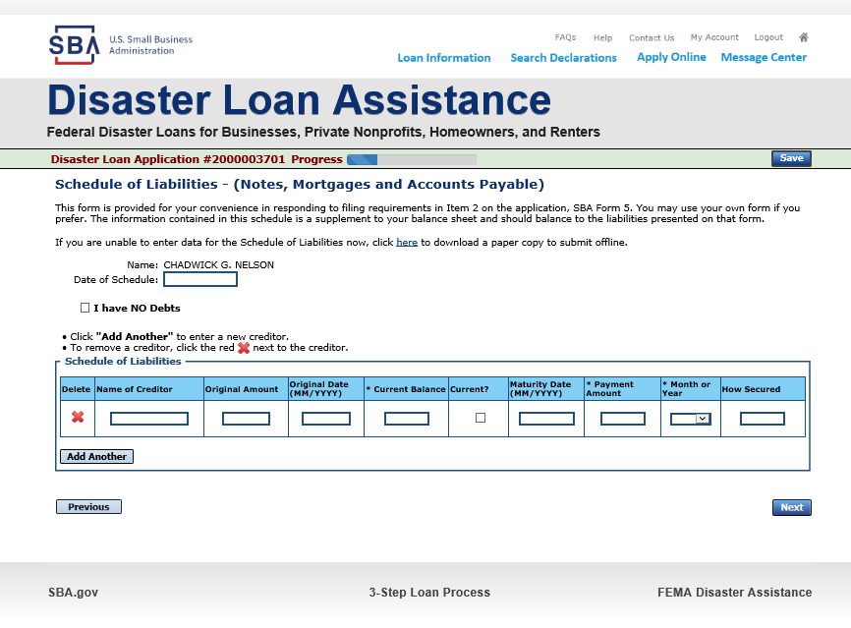
Schedule of Liabilities – SBA form 2202
Applicant would click on Schedule of Liabilities and either complete the SBA form or upload the applicant’s document

Slide 19
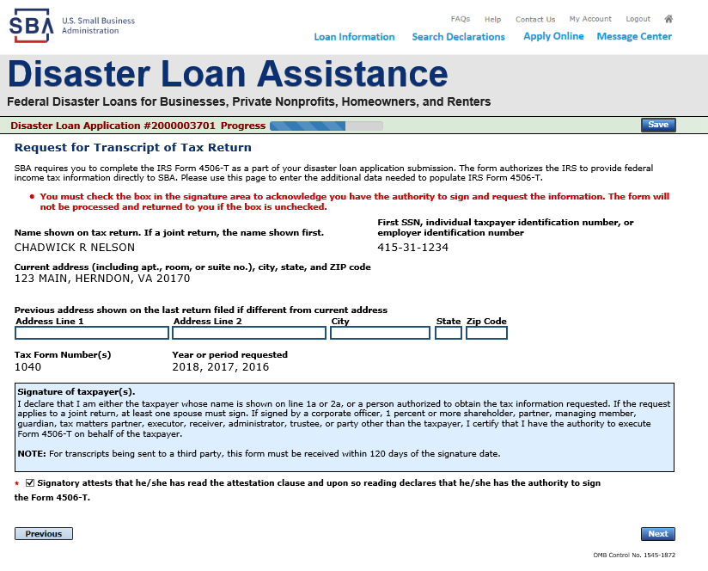
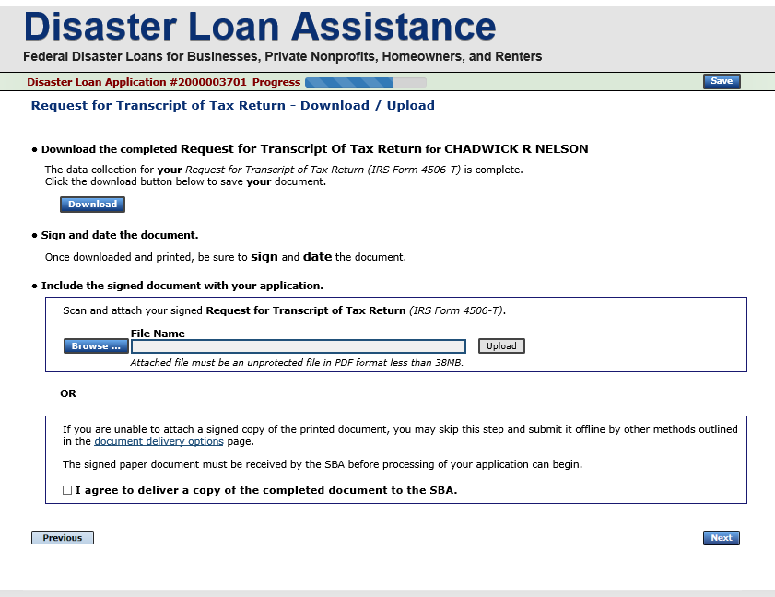
Uploaded 4506T
The 4506T can be uploaded once the form is printed and signed. You would need to save a copy on your desktop, once saved browse find the document and upload.
You could also opt to deliver offline

Slide 20
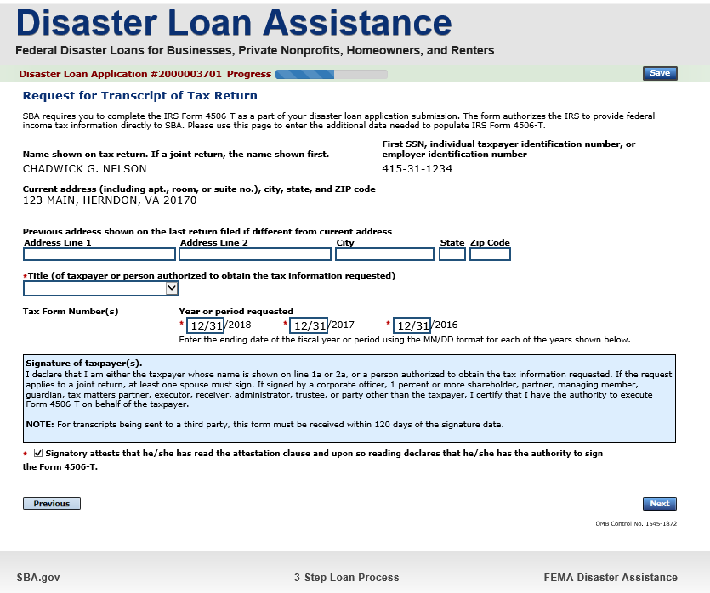
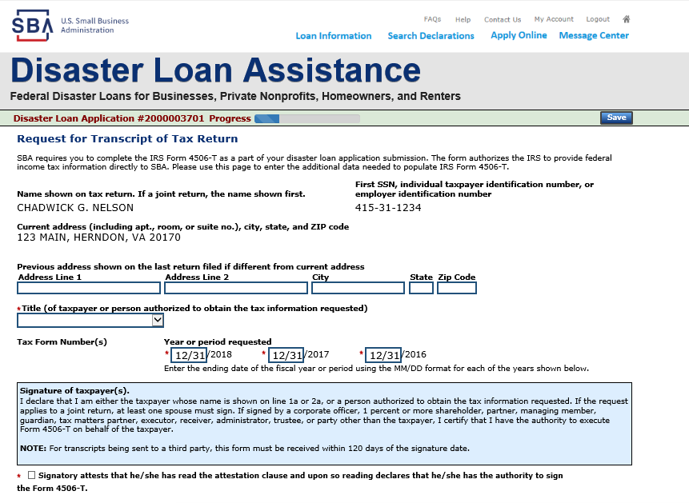
Electronically file 4506T
Each Applicant and Partner must submit a 4506T

Slide 21
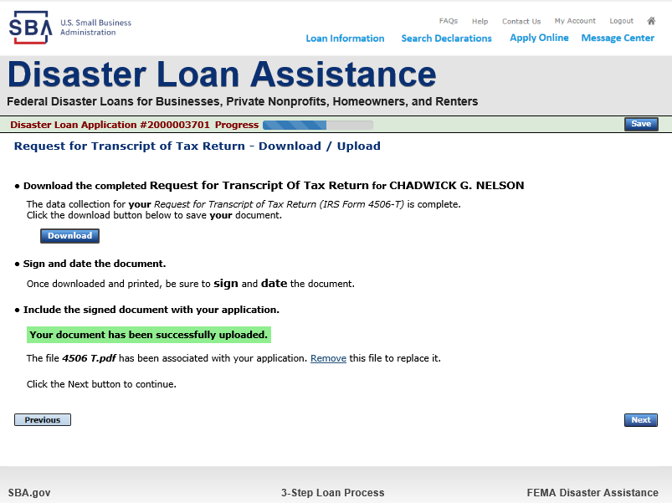
4506T Uploaded Successful
Once the 4506 T is uploaded you will receive a message back indicating the transmittal was successful. Make sure all fields are complete. All partners must submit this form for their individual and business taxes.

Slide 22
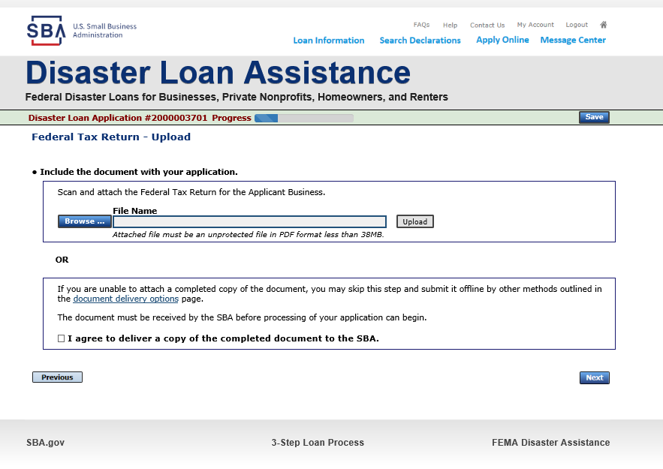
Tax Returns
To complete your application you must upload your most recent tax returns.
Taxes would be scanned and saved on the desktop. You would browse your desktop and then upload the tax returns.

Slide 23
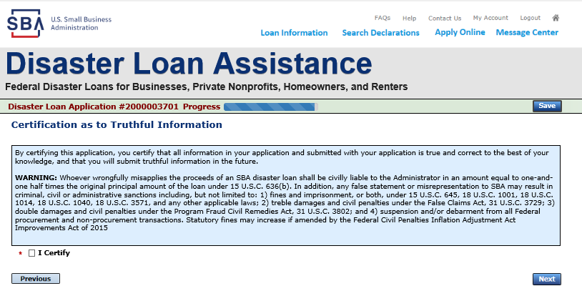
Certificate as to Truthful Information

Slide 24
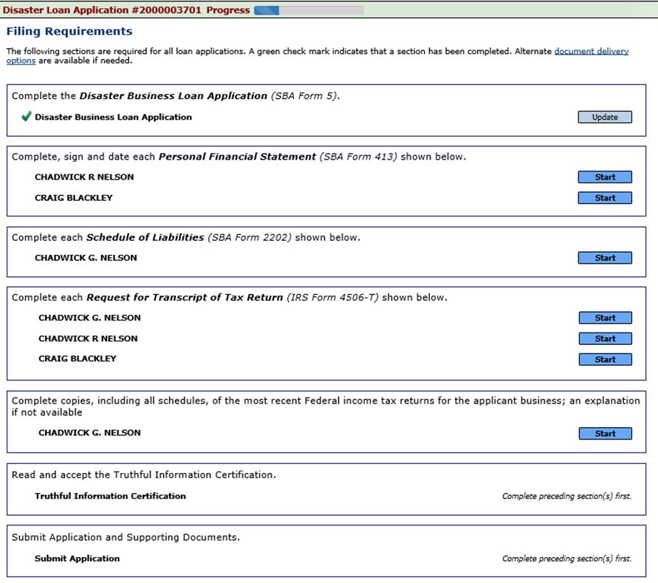
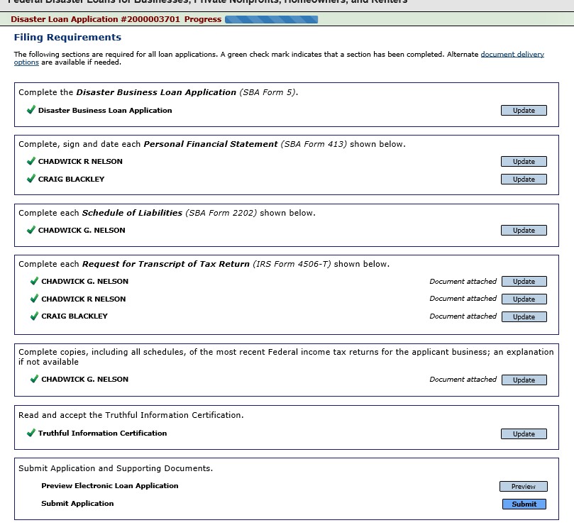
Filing Requirements Complete
You can see that all filing requirements no longer say “start” what shows now is all filing requirements have been updated and the application is ready to submit

Slide 25
Application Successfully Submitted
Once the application is successfully submitted you will get this page. In the right hand corner a message indicator will appear. The message confirms submittal of the application

Slide 26
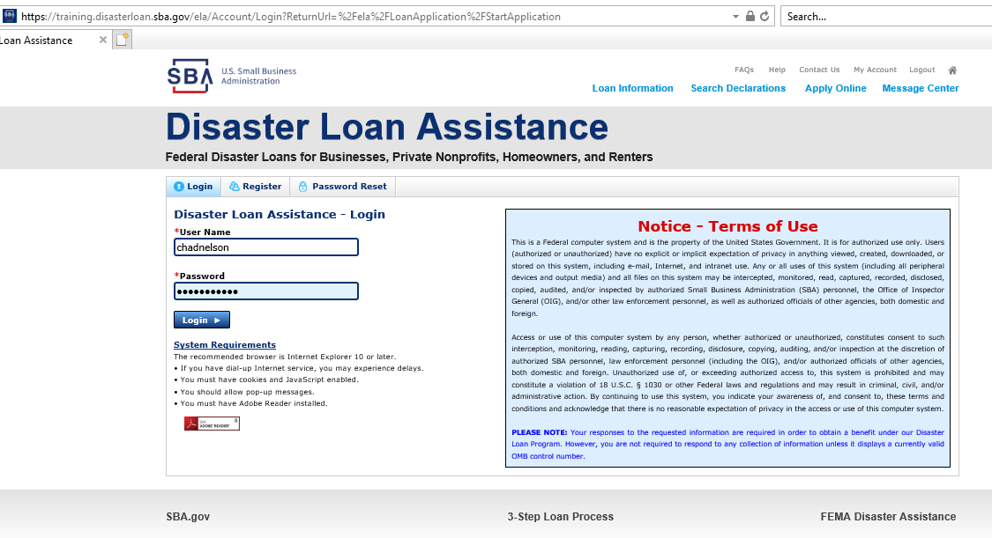
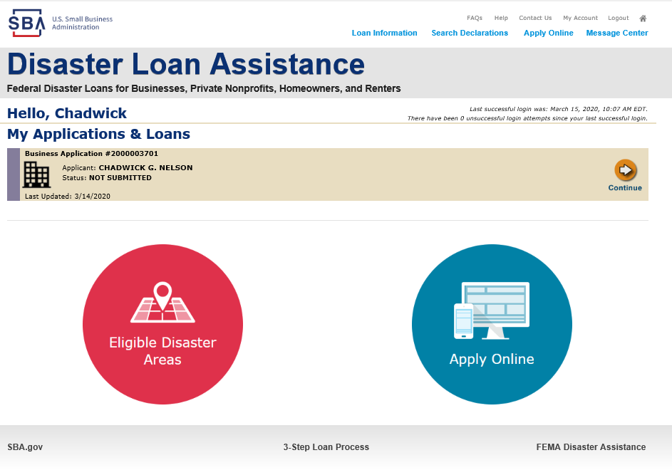
Returning to Complete Application
Input your user-name and password to complete a started application, once in click on “Continue”

Slide 27
Business Losses
A Sole-Proprietor will use “Sole-Proprietor” and “Economic Injury (EIDL).

Slide 28
Home/Personal Losses
The Loan Application will walk you though the process. Click “Save” to save the input and click “Next” to navigate to the next page.

Slide 29
Declaration Selection
On the same line as the “Save” icon you also can see the “Progress” of the Disaster Loan Application.
Enter your “State” and “County”

Slide 30
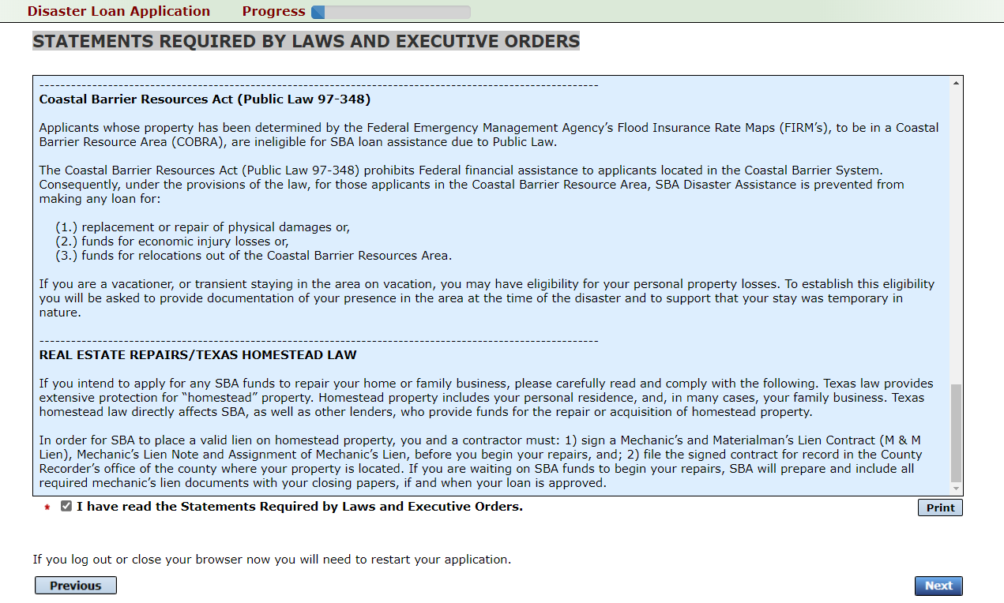
Certification and Executive Order
Read the “Warning”, check “I Certify” then click “Next”.
Read the information, check “I have read…” then click “Next”.

Slide 31
Filing Requirements
To continue with the application process click “Start” to complete SBA Form 5C.

Slide 32
Completing Form 5C - Sole Proprietor Loan Application
Fill in the information blocks and then hit next. Fields marked with a red asterisk is a required field.

Slide 33
Form 5C continued - Damaged Property Information
Fill in the information blocks and then hit next. Fields marked with a red asterisk is a required field.

Slide 34
Form 5C continued -Debts and Assets Information
Fill in the information blocks and then hit next. Fields marked with a red asterisk is a required field.

Slide 35
Form 5C continued - Disclosure Statements
Fill in the information as required and then hit next.
Fields marked with a red asterisk is a required field.

Slide 36
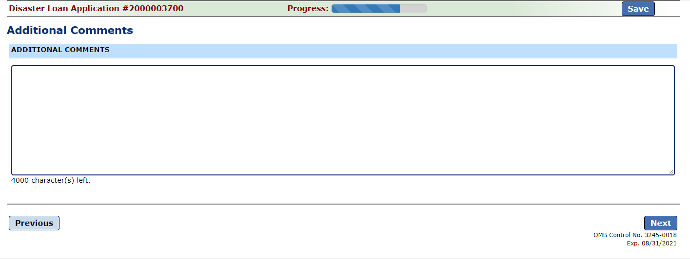
Form 5C continued - Consent and Additional Comments
Read the information, check “All the information…” then click “Next”.
Additional Comments are used for clarifying or additional information.
Click “Next” to continue the process.

Slide 37
Form 5C continued - Affiliated Businesses
Fill out the Affiliated Business information then click “Save”.
To continue the process click “Next”.

Slide 38
Completing IRS Form 4506-T
Once you have finished the SBA Form 5C, the tax transcript information will need to be completed.

Slide 39
Request for Transcript of Tax Return
Form 4506T can be submitted electronically, via upload or offline. If the eSign option populates click through the options until the document is successfully completed. If you upload the document you would save it on your desktop, select browse and then upload.

Slide 40
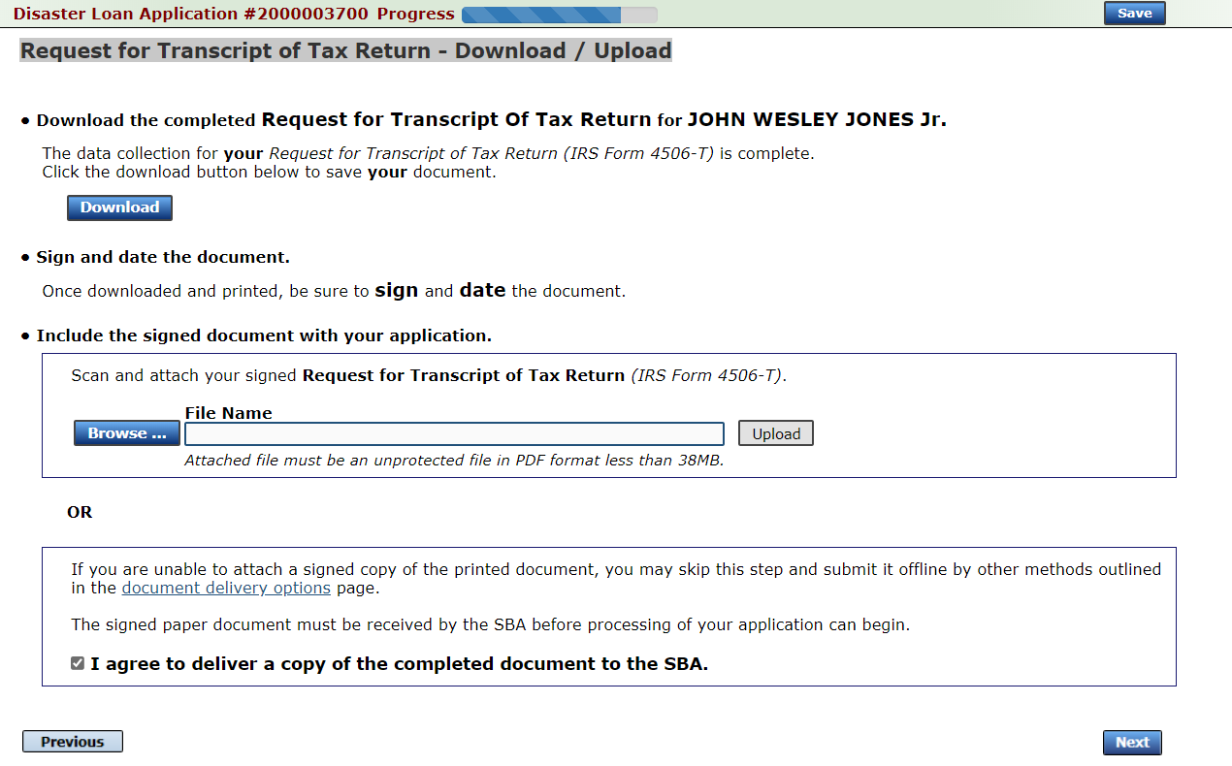
Request for Transcript of Tax Return - Download / Upload
If you chose to deliver a copy this alert will appear. And you will no longer be able to upload information. The document will have to be submitted offline.

Slide 41
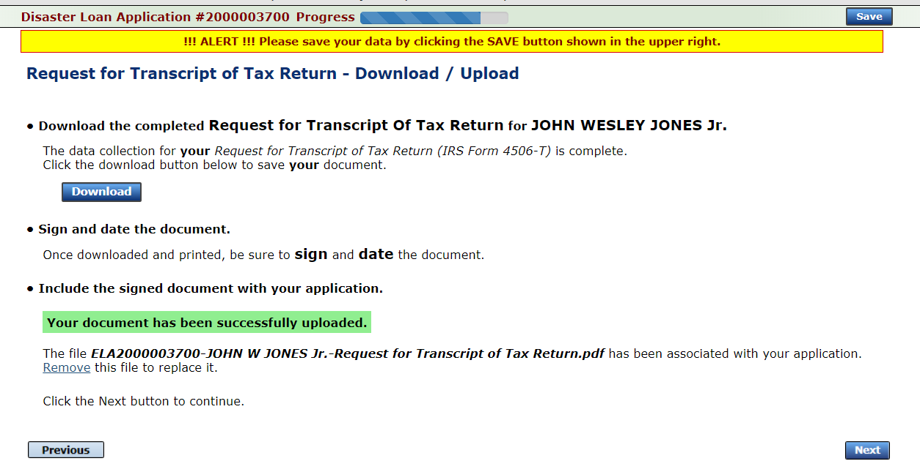
Request for Transcript of Tax Return - Download / Upload
Successfully Uploaded will appear when finished.
Then click “Next” to continue the process.
Once you have downloaded your tax returns you can upload.

Slide 42
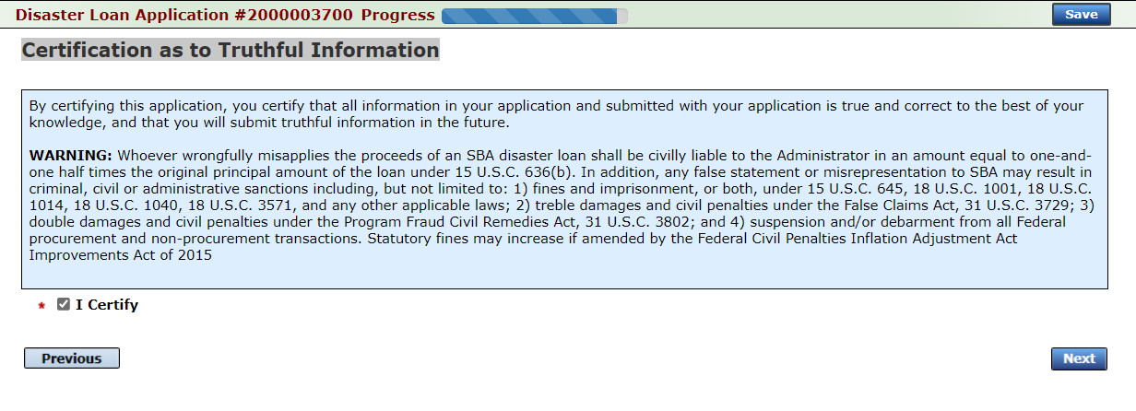
Filing Requirements
Once the tax returns are complete sign the final Truthful Information Statement.

Slide 43
Submit Application
Finally you can submit your application when the “Submit” icon appears.

Slide 44
Application Submission Confirmation
After submission you will see that your application number has been submitted.

Slide 45
Message Center

Slide 46
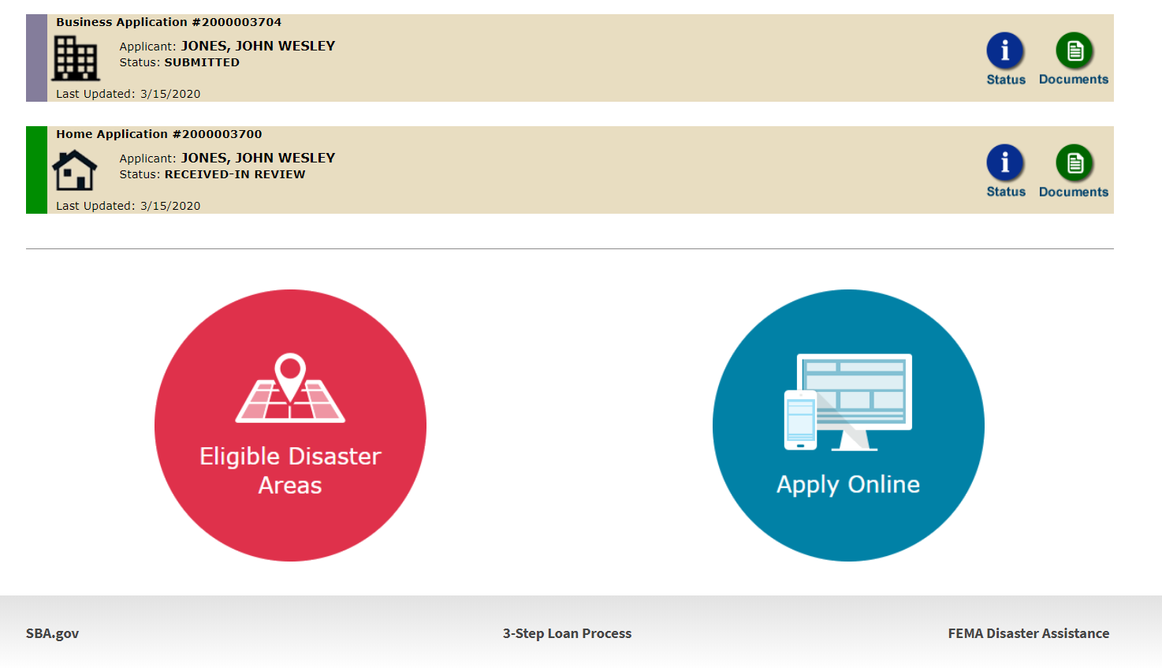
Home Page
After competing application you automatically return to the home page.
From here you can check the status of your application by clicking the “Status” icon.

Slide 47
Application Status

Slide 48
Special Note
If you receive a message like the one below, depress “SAVE” so that you don’t lose your information.

